Slide 1


E-barangay
Prepared by: Kamila Lagman David Warren Arcellana Jhonel Deluna Daren Mar Cabral Project Client: Abner, Arrieta Jr.

Slide 2


Slide 3
General Objectives
Create organized and secured information details for the barangay citizen to provide fast and accurate transactions. Help lessen complications such as information redundancy caused by repetitive registration and avoid missing data thus leading to successful document processes.
Educate the citizens by providing them with appropriate content of information and giving them easy access to this information.

Slide 4
Problem Statement
Citizen
Repeating filling out forms for barangay documents
Time-consuming processes of requesting for documents
Lack of knowledge about needed requirements
Not updated/unaware of happenings in the community

Slide 5
Problem Statement
Official
Files or information are vulnerable to calamities
Information given may be not authentic
In voting system, the number of voters are not accurate
Data redundancy when the user is requesting for documents

Slide 6
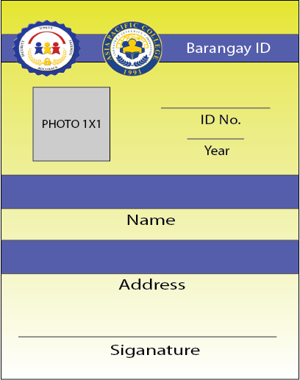
Benefits
Universal Identification System - Easily determined the location of the citizen by ID number
XX-XX-XXXX-XXXXX-XXXXXXXX
Region-Province-City/Municipality-Barangay-Number
Notes:
In Universal Identification System, the user who registered in the system, he / she will be given a specific identification number. The use of the identification number is to easily determined where the user lived.

Slide 7
Benefits
Proactive system - Controlling a situation by making things happen Example: - It can determined who are the beneficiaries - Help to track people by the activity - Statistics
Notes:
In 1st example, the system can determined who are the beneficiaries in certain event, for instance there is a event for elders, and the official can determined who are the people ranges their 50-60 and so on 2nd example, It can help the police to track their suspect by viewing the activity of certain individual
3rd It can be used in statistics like the number of men / women, children / elder and so on

Slide 8
Benefits
Easily requesting for barangay documents - All needed information will be saved and do not need to repeating filling out forms for requesting for documents

Slide 9
Benefits
Centralized payment transaction - All necessary payment can go through directly into the system.

Slide 10
Benefits
Information needed displayed in the system - Events / happenings, health, information will be displayed in the system. - Requirements for documents are listed Examples:
Evacuations centers
List of schools
Tourism
Map
Health
Educational Information

Slide 11
Benefits
Information are secured - All the account information will be stored and secured in cloud and backup
Information given are authentic - Officials making sure the information given by the citizen is authentic by uploading proof of identity and address (POI / POA)

Slide 12

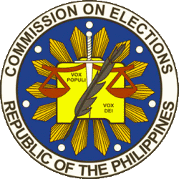





Government Agencies
PNP
Comelec
DILG
DOT
DOH
NDRRMC
PAGASA
Notes:
These are the government agencies who can benefits the system.

Slide 13
System Requirement
Browser | Processor | Recommended RAM | Recommended Disk Space | Operating System
Firefox | Pentium 4 | 512mb | 200mb | Any
Internet Explorer | 1-GHz | 512mb | 70mb | Windows
Chrome | Pentium 4 | 128mb | 100mb | Any
Opera | Pentium 2 | 256mb | 100mb | Any
Safari | 500-MHz | 256mb |  | Mac OS
Internet Connection
Notes:
Since, the e-barangay is a web based application, it will be needing a internet connections for both user and admins for real-time processing

Slide 14
Proposal
Users can pay online through external payment centers / gateway
System can able to work even offline (provincial)
All government documents can able to request in the system
TV white space accessible
Alert SMS for emergencies
Notes:
These are the list of future proposal or long term vision of the system,

Slide 15
Scope and Limitations
The Barangay System would be general, therefore the major activities of the system would focus on information, education, documents, events and health. The activities of the system are getting data from citizens to give them privilege in every service that the barangay offers.

